Slide 1
PRESENTATION ON DIFFERENTIAL EQUATION

Slide 2
CONTENTS :
INTRODUCTION OF DIFFERENTIAL EQUATIONS.
INVENTION OF DIFFERENTIAL EQUATIONS
ORDER AND DEGREE OF DIFFERENTIAL EQUATIONS.
FORMATION OF DIFFERENTIAL EQUATIONS.
ORDINARY DIFFERENTIAL EQUATIONS (ODE).
SOLUTION OF DIFFERENTIAL EQUATIONS.
METHODS FOR SOLVING ODE
REAL TIME APPLICATIONS OF DIFFERENTIAL EQUATIONS

Slide 3
What are Differential Equations
Calculus, the science of rate of change, was invented by Newton in the investigation of natural phenomena.
Many other types of systems can be modelled by writing down an equation for the rate of change of phenomena:
bandwidth utilisation in TCP networks.
acceleration of car.
population increase.
chemical change of some kind.
locus of a football.
All of the above behaviour can be captured by very simple differential equations.

Slide 4
A mathematical equation that relates a function with its derivatives is called differential equation,
the function usually represent physical quantities,
derivatives represent its rate of change
differential equation defines a relationship between the two.

Slide 5
History of Differential Equations
Origin of differential equations
Who invented idea
Background idea.

Slide 6
Origin of differential equations
In mathematics history of differential equations traces the development of differential equations form calculus, itself independently invented by English physicist Isaac Newton and German mathematician Gottfried Leibniz.
The history of the subject of differential equations in concise form a synopsis of the recent article ‘’The History of Differential Equations 1670-1950’’.

Slide 7
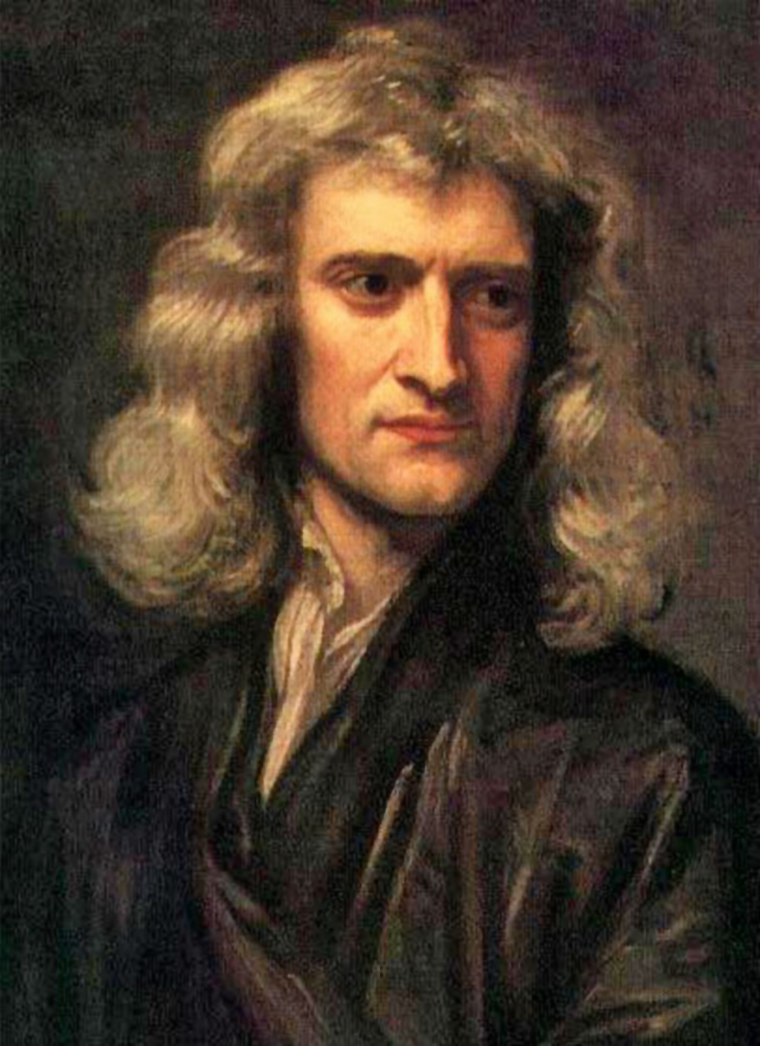
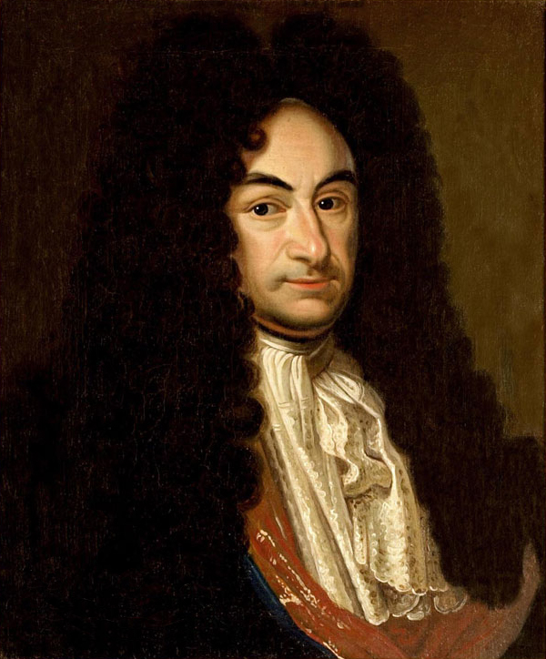
Sir Isaac Newton and Gottfried Leibniz

Slide 8
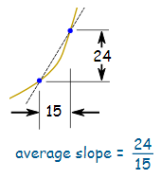
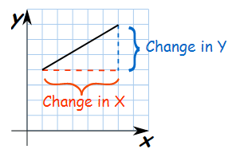

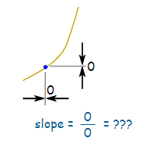
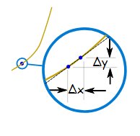

Slope and Rate of change
We can find an Average slope between two points.
But how do we find the slope at a point?
There is nothing to measure!
But with derivatives we use a small difference ...
...then have it shrink towards zero.

Slide 9
Differential calculus real time video

Slide 10
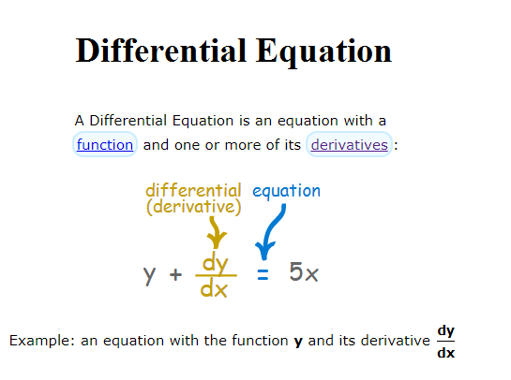

Slide 11
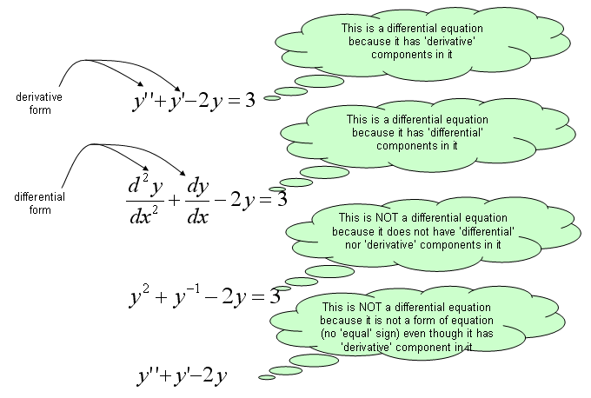

Slide 12
Formation of Differential Equations
the family of straight
lines represented by
Y
X
O
is a differential equation of the first order.

Slide 13
Formation of Differential Equations
Assume the family of curves represented by
where A and B are arbitrary constants.
[Differentiating (i) w.r.t. x]
[Differentiating (ii) w.r.t. x]

Slide 14
Formation of Differential Equations
[Using (i)]
is a differential equation of second order
Similarly, by eliminating three arbitrary constants, a differential equation of third order is obtained.
Generally eliminating n arbitrary constants, a differential equation of nth order is obtained.

Slide 15
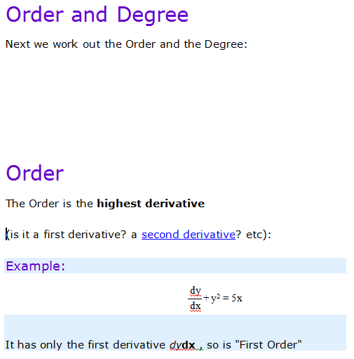
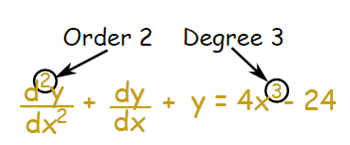

Slide 16
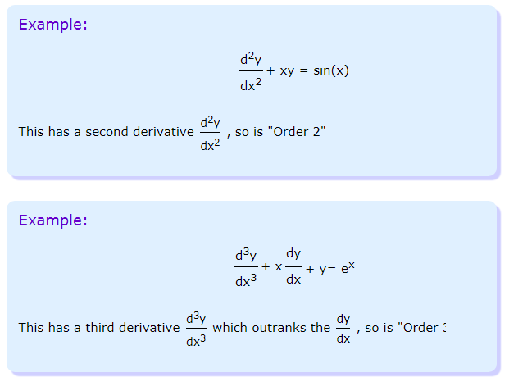

Slide 17
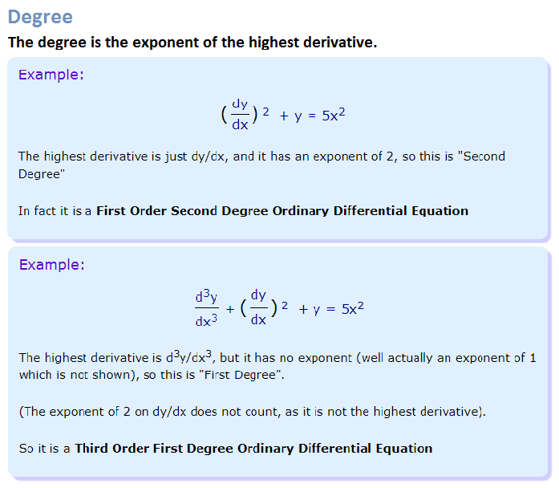

Slide 18

Solving :
We solve it when we discover the function y (or set of functions y).
There are many "tricks" to solving Differential Equations (if they can be solved!), but first: why?

Slide 19
Solution of a Differential Equation
The solution of a differential equation is the relation between the variables, not taking the differential coefficients, satisfying the given differential equation and containing as many arbitrary constants as its order is.
For example:
is a solution of the differential equation

Slide 20
General Solution
If the solution of a differential equation of nth order contains n arbitrary constants, the solution is called the general solution.
If the solution of a differential equation of nth order contains n arbitrary constants, the solution is called the general solution.
is the general solution of the differential equation
is the general solution of the differential equation
is not the general solution as it contains one arbitrary constant.
is not the general solution as it contains one arbitrary constant.

Slide 21
Particular Solution
A solution obtained by giving particular values to the arbitrary constants in general solution is called particular solution.
is a particular solution of the differential equation .

Slide 22
SOLUTION OF DIFFERENTIAL EQUATION.

Slide 23

Variable Separable
The first order differential equation
Is called separable provided that f(x,y) can be written as the product of a function of x and a function of y

Slide 24
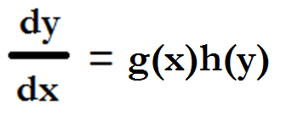
Suppose we can write the above equation as
We then say we have “separated” the variable, By taking h(y) to the LHS, the equation becomes.

Slide 25


On Integrating, we get the solution as
Where c is an arbitrary constant.

Slide 26
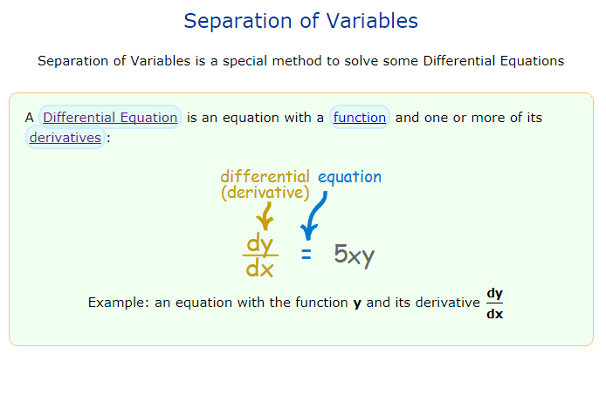

Slide 27
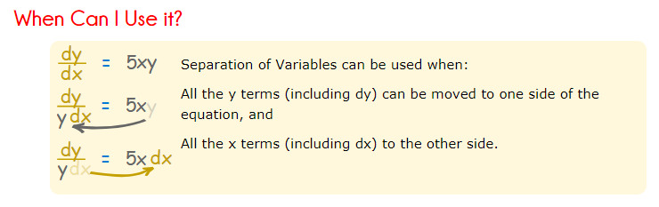

Slide 28
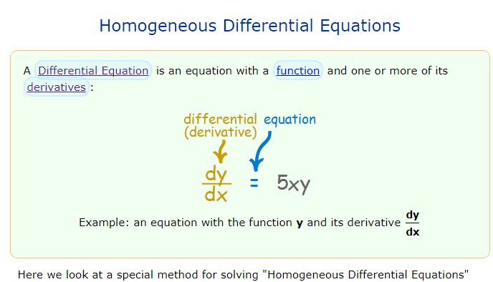

Slide 29
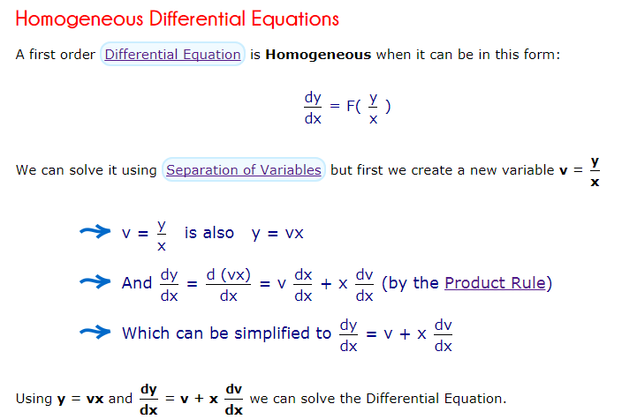

Slide 30


